Slide 1

WELCOME COHORT THREE!
  Facilitators: Kelly Ussery-Kronhaus, MD, FAAFP, Hackensack Meridian Health Ocean University Medical Center and Theresa Azevedo Rousso, MPA, Regional Senior Director and Designated Institutional Official, Kaiser Permanente Northern California
  National Advisory Council: Lisa Crouse, MD, MS, FACOG, Senior Vice President, Institutional and Program Accreditation and Julie Dagam, PharmD, BCPS, FASHP, FPSW, Director, Residency Accreditation Services, American Society of Health System Pharmacists
Mountain Area Health Education Center
Aurora Health Care
OBGYN Waste
AI FM
St. Lukes University Health Network
Clinic to Curb
Resident Clinics
Rapid Response Sim
Ochsner Health
Atrium Health CMC
NI X Meeting Three Storyboard Presentations

Slide 2

11:35 – 1:45 pm: Storyboard Presentations
Welcome & Introductions
  Facilitators:
  Kelly Ussery-Kronhaus, MD, FAAFP, Hackensack Meridian Health Ocean University Medical Center
  Theresa Azevedo Rousso, MPA, Regional Senior Director and Designated Institutional Official, Kaiser Permanente Northern California
  National Advisory Council:
  Lisa Crouse, MD, MS, FACOG, Senior Vice President, Institutional and Program Accreditation
  Julie Dagam, PharmD, BCPS, FASHP, FPSW, Director, Residency Accreditation Services, American Society of Health System Pharmacists
Assign a Timekeeper
8-10 Minute Storyboard Presentations
Purpose: Share & Learn = Please provide feedback & join in discussion after each presentation
1:35 – 1:45: Overall Reflections from Facilitator & National Advisory Council
1:00 – 1:10 pm: Suggested Break time
(Facilitators and team to determine when/if a short break is needed)
Notes:
Read the slide which describes today’s objectives Be sure to note there are two options for time keeping:
If you take the 10-minute break:
7 projects @120 minutes = 12-minute presentations & 5 minutes for group feedback
If you do not take the 10-minute break:
7 projects @ 130 minutes = 13-minute presentations & 5 minutes for group feedback

Slide 3
Mountain Area Health Education Center

Slide 4



Implementing Inpatient Direct Observations
Alyssa DeMutis DO, Alec Knupp MD,
Nancy Kubiak MD FACP, Melissa McKay MD, Adrian Singson MD FACP
Introduction: Background & Context
WHY: Direct Observations allow real-time feedback & allow learners to grow/develop professional identity
HOW:
Implement an inpatient Direct Observation Pilot to evaluate resident performance according to Entrustable Professional Activities in the inpatient setting modeled on current ambulatory
Direct Observations

Slide 5
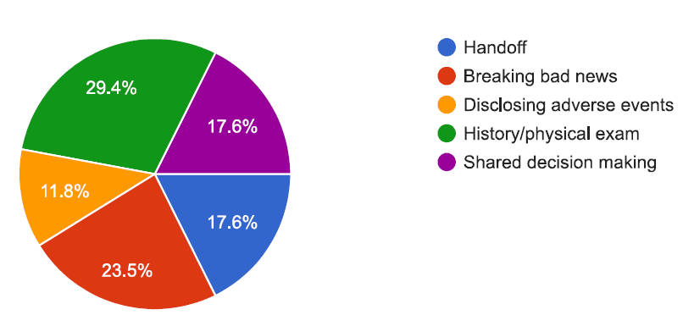
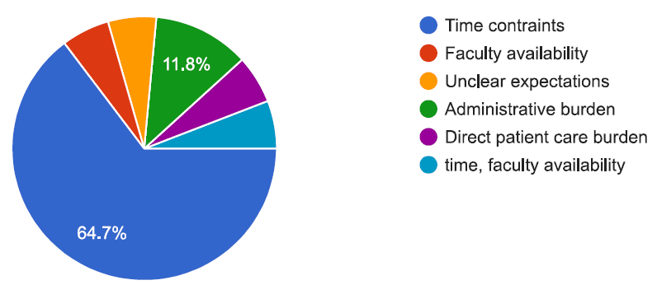
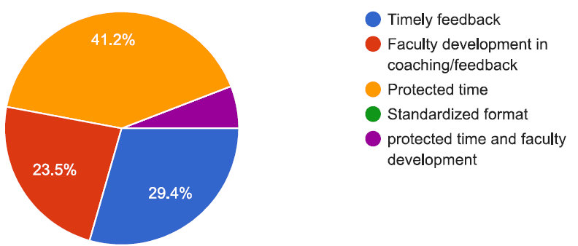
Aim/Objectives/Alignment
Implementation of Inpatient Direct Observations
Develop resident proficiency in Entrustable Professional Activities for inpatient wards
Develop faculty proficiency with Direct Observations
Percentage of residents identifying improvement areas for direct observations
A: Most important Skills/Behaviors
B: Barriers/Challenges;
C: How to Improve Value
Handoff
Breaking bad news
Disclosing adverse events
A
History/physical exam
Shared decision making
Time constraints
Faculty availability
Unclear expectations
B
Administrative burden
Direct patient care burden
Time, faculty availability
Timely feedback
Faculty development in coaching/feedback
Unclear expectations
Protected time
C
Standardized format
Protected time & faculty development

Slide 6
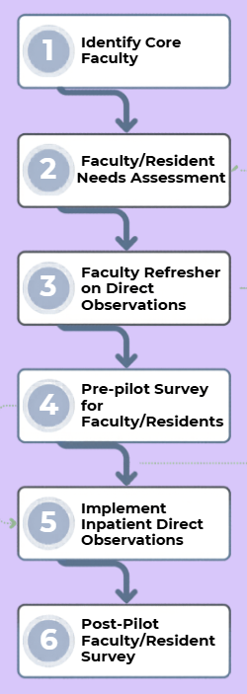
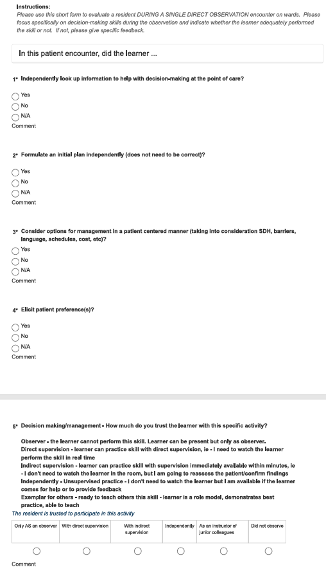
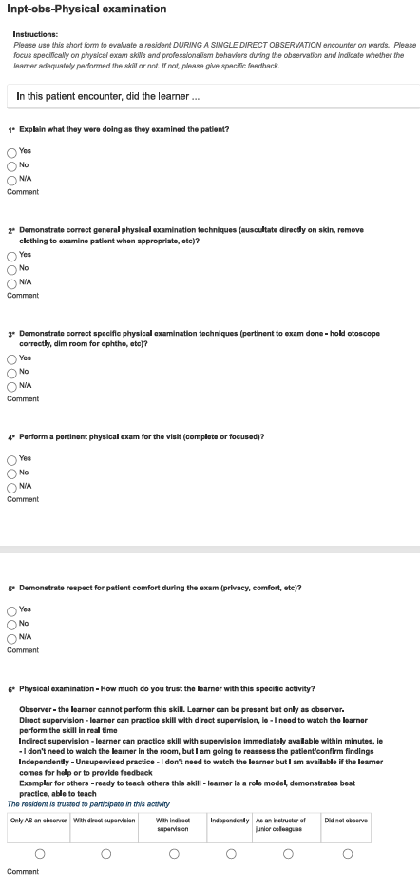
Measures/Interventions/Changes

Slide 7
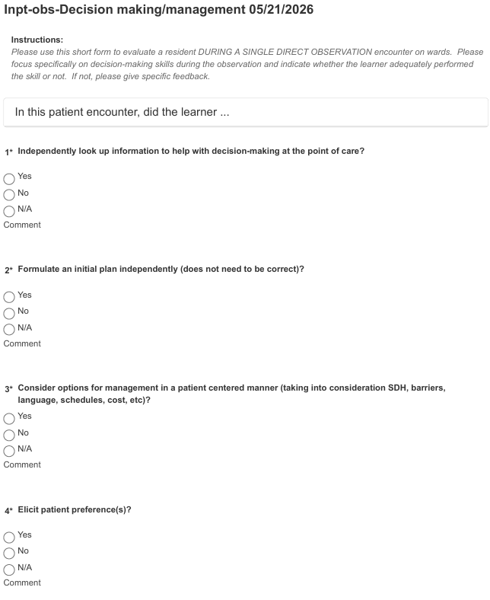
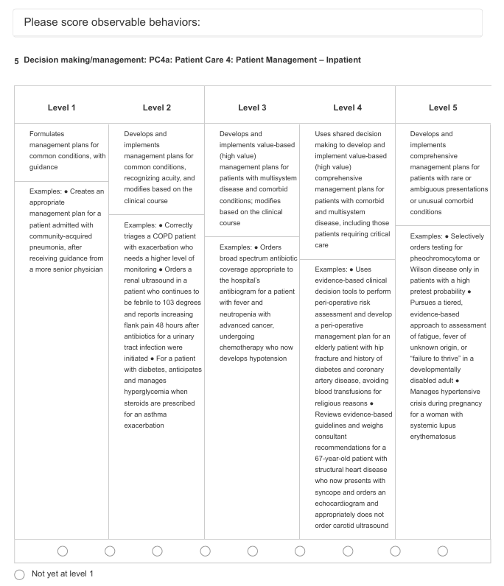
Measures/Interventions/Changes

Slide 8
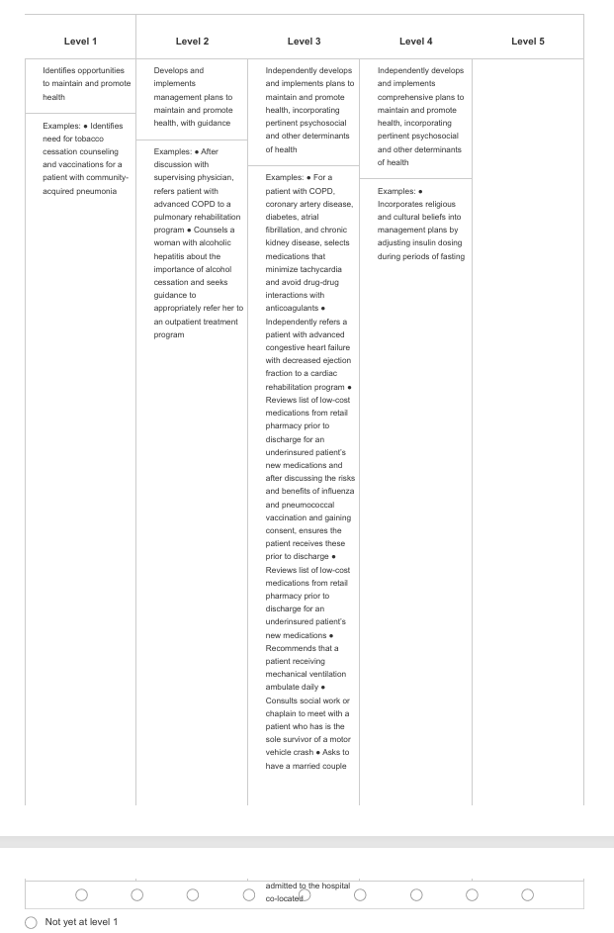
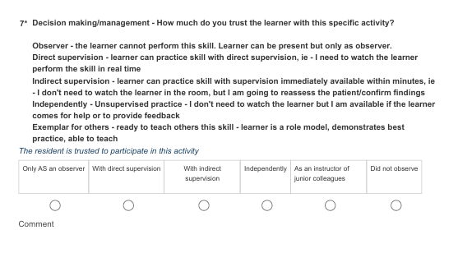
Measures/Interventions/Changes

Slide 9
Barriers & Strategies
Identifying expansion team members – turnover, new interns, timing in resident life cycle
Faculty spread – invested stakeholders, distracted stakeholders; GME-hired stakeholers, third party entity-hired stakeholders
Incorporating rising/new chiefs
Expanding AIAMC presence at MAHEC for project sustainability
Lack of easy/transparent interdepartmental collaboration over time
Publication landscape

Slide 10
Results
Notes:
How will you know if you have achieved your aim?
What measures/metrics/data are you using?

Slide 11
Discussion
Pilot moved into expansion phase
Pilot team leading/supporting expansion teams
Incorporating chief residents, rising chiefs
3 expansion projects:
Include PGY3s as evaluators for Inpatient Direct Observations
Compare PGY3s vs. faculty as evaluators for Ambulatory Direct Observations
Study CCC data after incorporating Milestones to Direct Observations
IRBs drafted/submitted for each
References:
1 Cooper at al. Competency-based medical education at the front lines of patient care. N Engl J Med 2025;393:376-88. DOI: 10.1056/NEJMra2411880
2 Dine et al. Accuracy of Entrustment-Based Assessment: Implications for Programs and Patients. JGME 2024; DOI:http://dx.doi.org/10.4300/JGME-D-23-00275.1
3 Dyrbye et al. Redesigning the Learning Environment to Promote Learner Well-Being and Professional Devekopment. Acad Med. 2020;95:674–678
4 Kelly et al. Education Research: The Narrative Evaluation Quality Instrument. Neurology 2020;94:91-95. doi:10.1212/WNL.0000000000008794
5 Warm et al. Entrusting Observable Practice Activities and Milestones Over the 36 Months of an Internal Medicine Residency. Acad Med. 2016;91:1398–1405. First published online June 28, 2016 doi: 10.1097/ACM.0000000000001292

Slide 12
Aurora Health Care
OBGYN Waste

Slide 13



Introduction: Background & Context
Teaching waste sorting on L&D is a team sport
Aurora Health Care OBGYN
Haley Primuth, MD; Kari Schmidt Oliver, MD; Manuel Lamptey, MS; Anne Getzin, MD; Deborah Simpson, PhD
Climate change has known impacts on the health of the maternal-fetal dyad
  Extreme heat has been linked to increased rates of fetal growth restriction, preterm delivery and stillbirth
Recommended standard percentage of overall medical waste disposed of as regulated medical waste is 15%, while the actual percentage is 50-70%
  Incineration of regulated medical waste (“red bag waste”) emits greenhouse gases, heavy metals, toxins and particulate matter
Work on labor & delivery (L&D) generates significant waste
  3-10% of total waste generated on L&D should be classified as regulated medical waste (RMW)

Slide 14
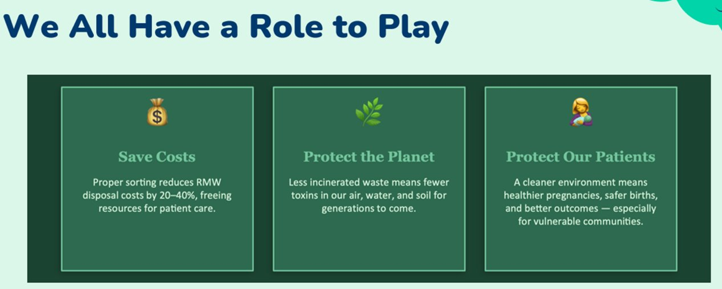
Aim/Objectives/Alignment
Aim: To decrease total L&D red bag waste by 10% through education of OB/GYN residents and faculty regarding the environmental impact of our work on our patients and proper waste sorting
Alignment: Advocate Health is nationally recognized as a Champion for Sustainability
Aurora Sinai is in the top 20% of hospital applicants for sustainability programs

Slide 15
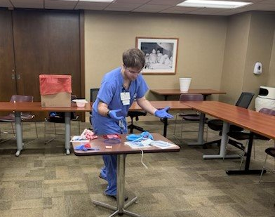
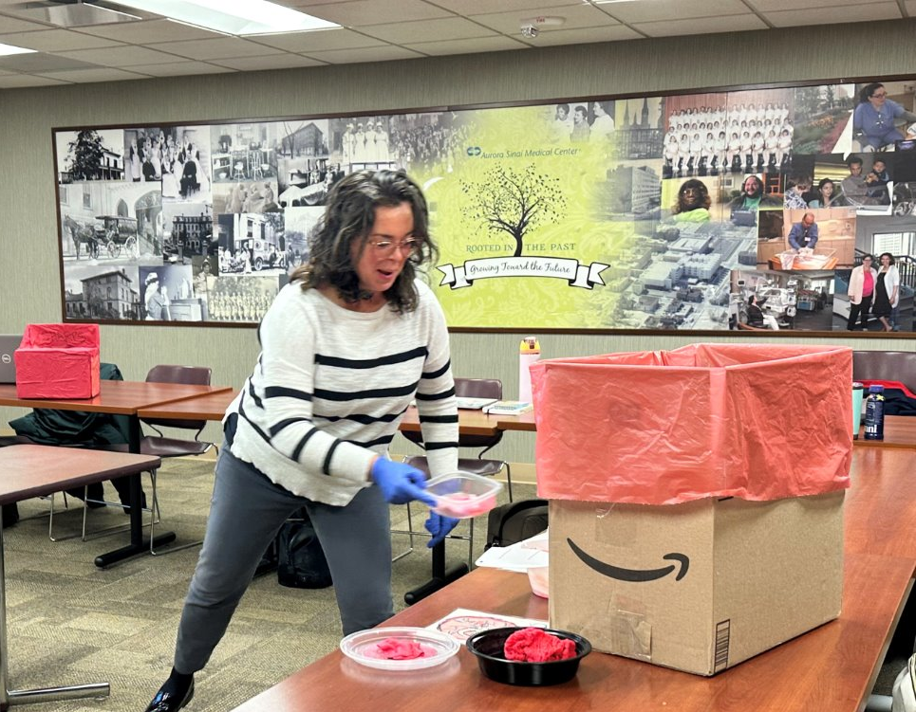
Measures
Waste Weights: Obtain weights for the red bag and municipal was obtained from 40 vaginal deliveries
Calculate baseline percentages of red bag waste relative to total waste
Knowledge Quiz + attitudes re: role in reducing waste
The Waste Race

Slide 16
Interventions | Changes
Learning/assessment tools
Quiz & Attitude
  34 items to assess 3 domains of knowledge (ie, waste sorting, environmental impacts, Advocate Health’s sustainability priorities) and personal attitudes regarding sustainability efforts
The Waste Race
  Participants sort simulated waste into appropriate receptacles scattered about the room
  Tracked for time to completion and accuracy
  Brief debrief of accuracy / person
Brief Didactic
  Focused on quiz knowledge domains
Waste Infographic
  Adapted specifically to pertinent sorting guidelines to display on L&D

Slide 17
Barriers Strategies
Obtaining baseline and post-intervention waste weights from deliveries on L&D
Coordination of quiz/game/didactic amongst a group of busy OBGYN residents and faculty
Recruitment of surgical technicians on L&D. Scale used to measure various waste types following delivery
Time utilized during required resident education block, day chosen when largest amount of faculty intended to attend

Slide 18
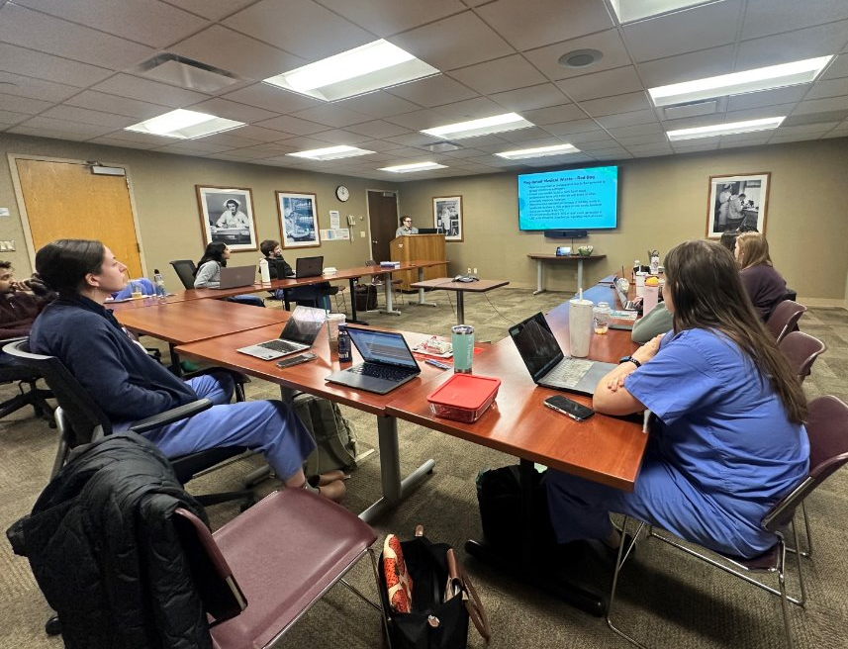
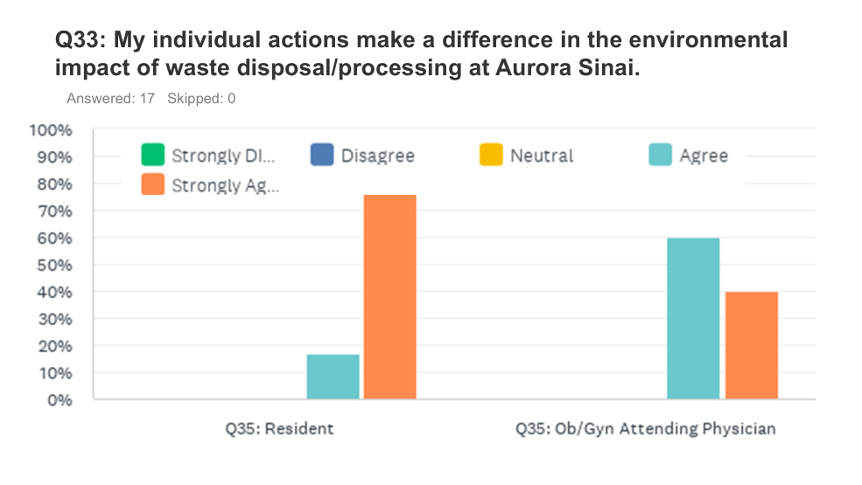
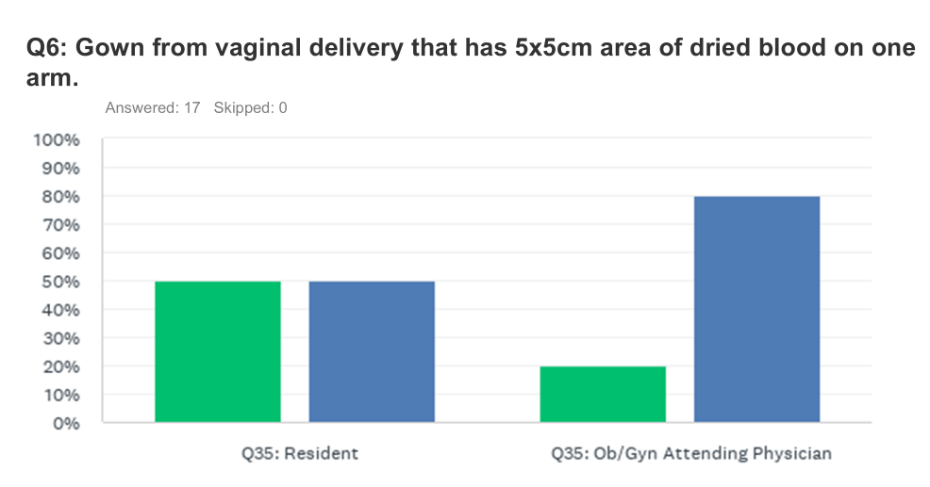
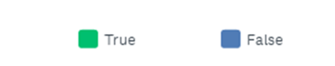
Results
Quiz & Attitude
  N= 21: Residents=16; Faculty=5
  Mean: 69% | Range: 45-94%
Waste Race
  N= 22: Residents=16; Faculty=6
  18 Items: sharps (N=2): municipal (N=9); red bag (7)
  Time Range: 1.5-3 min

Slide 19
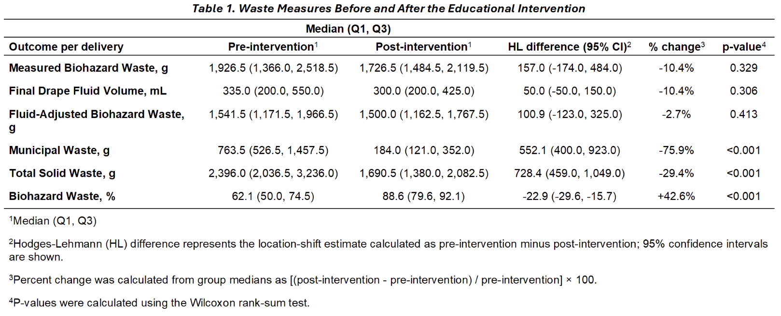
Results
Delivery Waste Weights
  No statistically significant difference in red bag waste (biohazard waste) between pre- and post-intervention periods – 10.4% decrease in the median
  Final drape fluid volume and fluid-adjusted biohazard waste did not differ significantly
  Municipal waste decreased by 75.9%, total waste decreased by 29.4%
  Proportion of the total waste going into red bag increased by 42.6%

Slide 20

Discussion
Next Steps
Approval of updated infographic
Broaden study population
Reassess knowledge retention
Areas Seeking Guidance
Institutional acceptance of updated infographic for L&D
Sustainability of change

Slide 21
St. Lukes University Health Network
Clinic to Curb

Slide 22

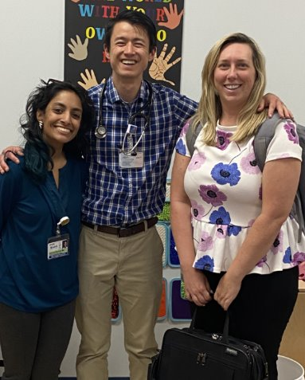
Clinic to Curb: Resident Physicians in Street Medicine
Omama Humayun, MD; Daryoush Shahin, MD; WeiYu (James) Lu, DO; Kristina Ramdial, MD; Hira Ahmed, DO; ​Muhammad Shabbaz, MD; Gregory Dobash, MD; Thomas McGinley, MD; Danielle Godfrey, MHA​
Introduction: Background & Context
The St Luke’s Rural Family Medicine Residency offers primary care to homeless and domestic violence shelters on a walk-in basis, regardless of payment ability. A new “Street Medicine” curriculum, including point-of-care ultrasound and wound care, has been and continues to develop using non-traditional settings. Resident knowledge, skills, and attitudes will be assessed before and after the rotation. Team member knowledge will be assessed via pre/post test surveys as part of our Grand Rounds series.
Timeline
2023 | Program initial involvement with Street Medicine
2025 | Awarded HRSA grant to expand our Street Medicine Curriculum
January 2026 | Launch of Street, Wilderness and Rural Medicine Grand Rounds series
April 2026 | Initial pre-test survey distributed to residents to assess comfortability with street medicine.
June 2026 | Post-test survey distributed to the class of 2026. Pre-test distributed to the class of 2029.

Slide 23
Aim/Objectives/Alignment
Develop and expand Street Medicine Curriculum
Evaluate residents' competencies before and after completion of clinical experiences ​
Assess residents' knowledge, skills, and attitude in serving marginalized populations during residency, and after their post-graduate careers​
Assess the knowledge level of Grand Rounds participants using pre/post tests related to the content.

Slide 24
Measures
​Data is collected via the Research Electronic Data Capture System (REDCap)​.
Residents will be surveyed during the pre/post periods of the project. Specifically, at the start of the residency program and at the conclusion of the residency program.
Grand Rounds attendance is tracked and maintained.
Participants in the Grand Rounds series will complete a pre/post test survey at the start and end of the session.

Slide 25
Interventions/Changes
All team members have completed IRB training.​
IRB approval has been received.​
The Street, Wilderness, and Rural Grand Rounds series launched in January 2026.
Each Grand Rounds session includes pre/post surveys to assess knowledge related to the topic being presented.​ Data collection began in April 2026.
An overarching competency survey to measure baseline skills and attitudes prior to the Street Medicine rotation.​ Initial surveys have been distributed.

Slide 26
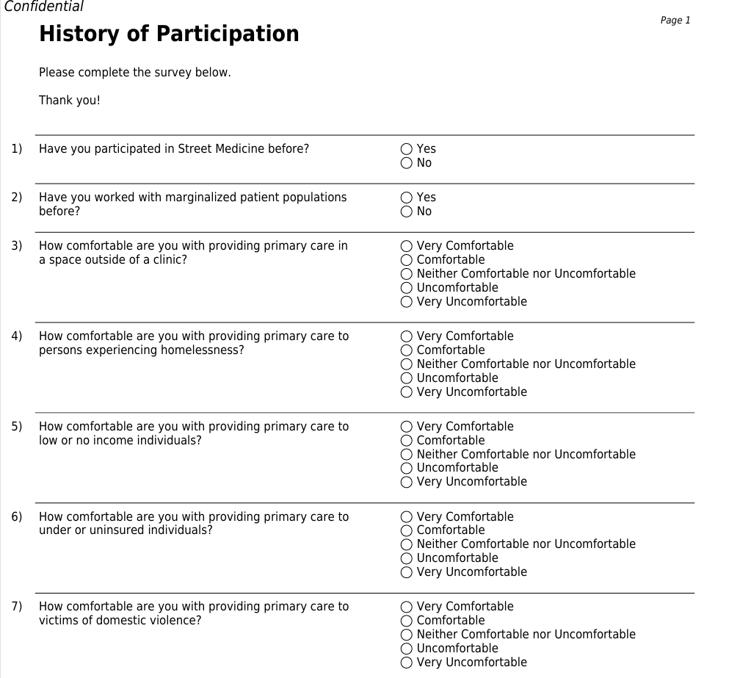
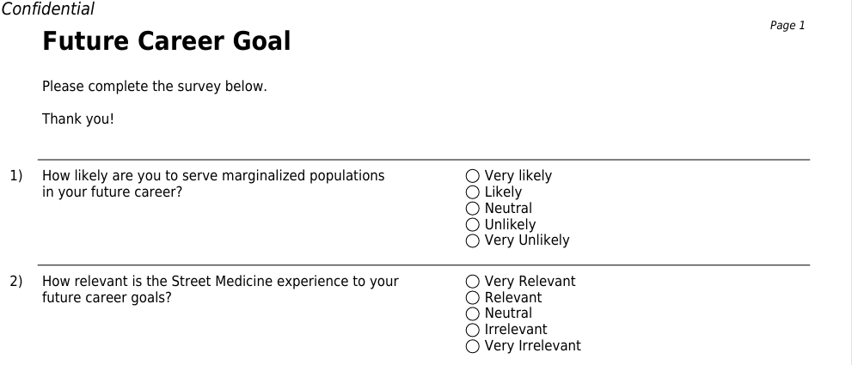
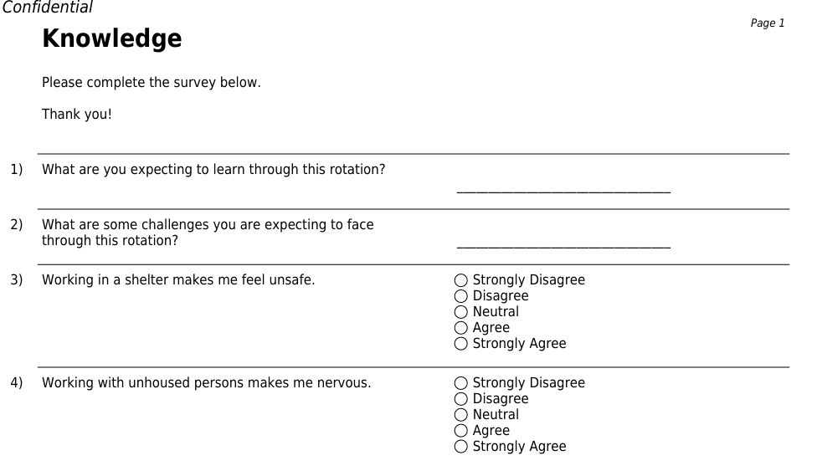
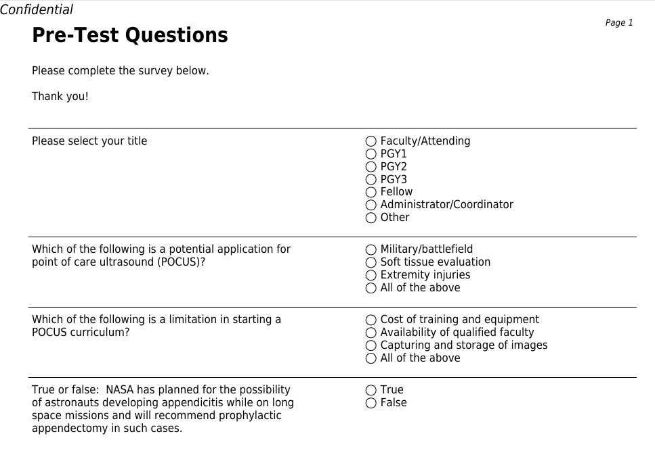
Barriers & Strategies
Image 1. Resident Survey
Distribution of the Resident Survey (Image 1) has been completed.
To strengthen data collection and reporting, survey distribution was revised so that each residency class receives an individualized survey link, enabling more accurate tracking of participation, completion, and results.
Initial barriers: survey platform limitations and low survey completion rates.
Survey 2. Sample Grand Rounds Pre/Post Test
Distribution of the Grand Rounds Pre/Post-Test (Image 2) was implemented beginning with the April 2026 Grand Rounds session.
Survey completion rates remain an ongoing challenge.
Survey dissemination was updated to improve response rates, with pre-surveys sent the Monday before via email and on the day of Grand Rounds through Teams, and post-surveys distributed at the end of the session through Teams and email.

Slide 27
Results
Table 1. Completed Grand Rounds Sessions
Grand Rounds Topic | Speaker | Attendance Count | Pre-Test Response Rate (%) | Post-Test Response Rate (%)
Street Medicine Dermatology | Stephen Ansah-Addo, MD | 26 | 34 | 6
Field Dentistry | Soumaya Bendjilali, DDS | 16 | 31 | 18
Management of Diabetes in Low-Resource Areas | Remy W. Mimms, DO | 21 | 42 | 19
Managing Chronic Medical Conditions of the Traveler and Street Medicine Patient | Greg Dobash, MD | 17 | 58 | 29
Parasites and Protozoal Infections in Travel/Street Medicine | Thong Le, MD | 24 | 33 | 29
Portable Ultrasound in Wilderness and Street Medicine | Greg Dobash, MD | 20 | 35 | 30
Grand Rounds Topics Prior to Pre/Post Survey:
Mental Health in Rural/Housing Insecure Populations
Low-Barrier Approach to Addiction
Social Drivers of Addiction
Future Grand Rounds Topics:
Safety and Security While Traveling/Street Medicine
Women’s Issues/Health in Wilderness/Street Medicine
Cold Injuries
Management of Burns
Table 1 includes completed Grand Rounds sessions that included Pre/Post Test as part of this project (April 2026 – September 2026). Our Grand Rounds series had additional lectures prior to pre/post test data collection (January 2026 – March 2026). Our Grand Rounds series features multidisciplinary attendance from family medicine, addiction medicine and administration.
Table 2. Resident Survey Update
Survey Recipients | Pre Survey Date | Response Rate | Post Survey Date | Response Rate
Class of 2026 | 4/15/2026 | 4/4 | 6/30/2026 | 3/4
Class of 2027 | 4/15/2026 | 4/4 | 7/6/26 | 7/12
Class of 2028 | 4/15/2026 | 4/4 | 8/10/26 | 9/12
Updates to Resident Survey
We initially distributed a single survey to the entire group. For the Class of 2029 pre-test and Class of 2026 post-test, we transitioned to individualized survey links to improve tracking of response completion and data collection.
Table 2 includes an update on our survey distribution to residents and alumni. The survey measures resident comfortability with Street Medicine and caring for the unsheltered population outside of a traditional clinic setting.

Slide 28
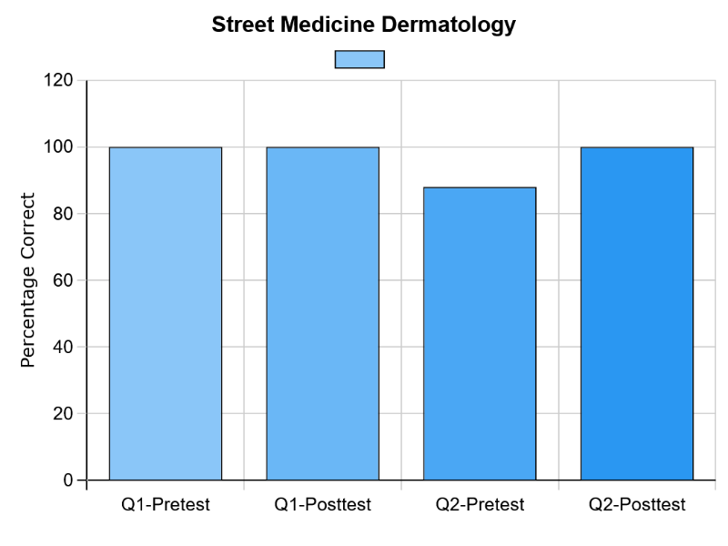
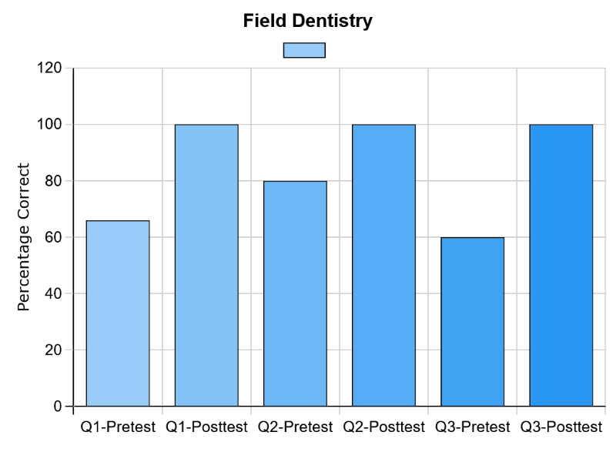
Results

Slide 29
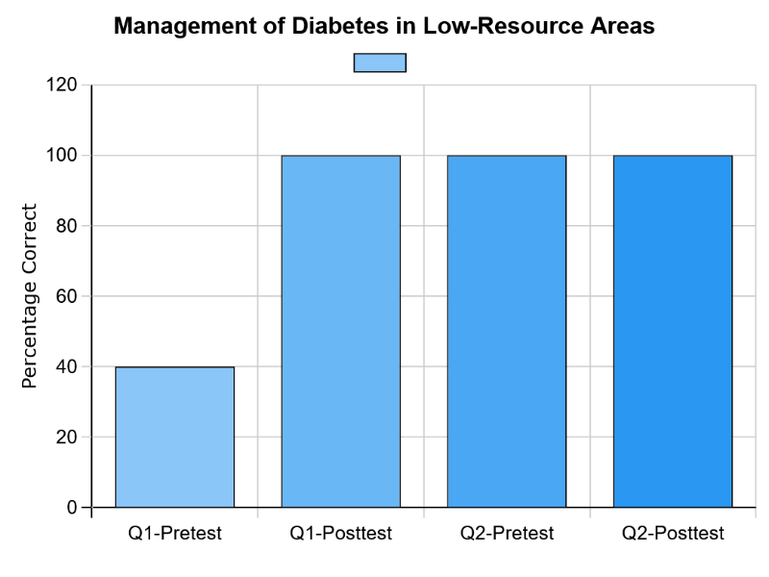
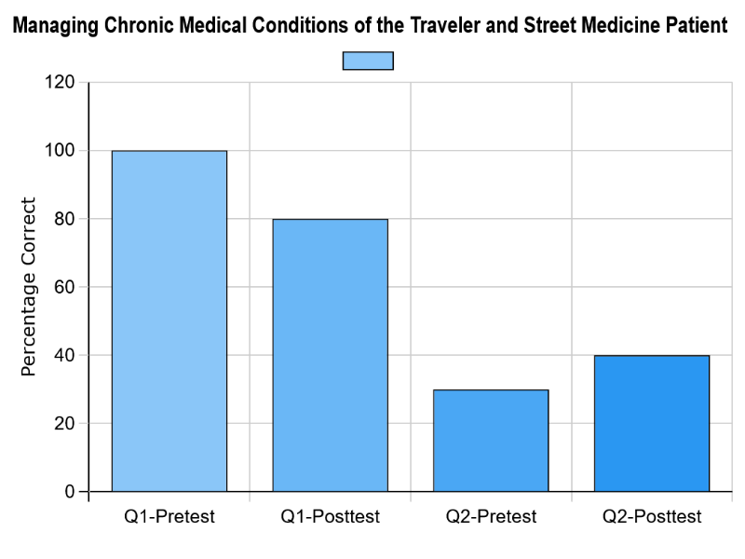
Results

Slide 30
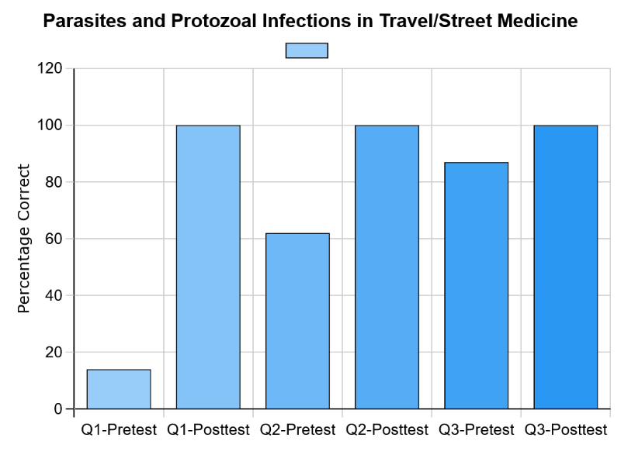
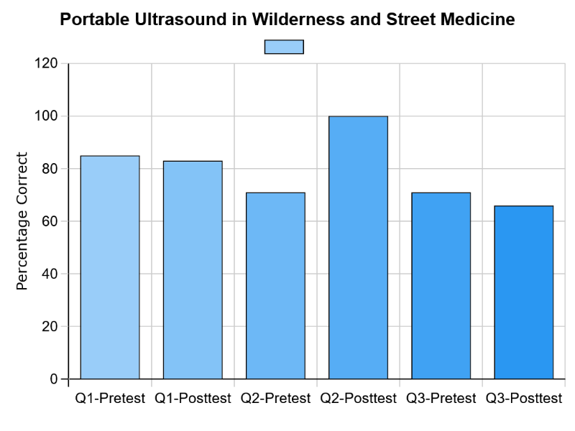
Results

Slide 31
Discussion
The Street Medicine Curriculum continues to expand as the program progresses through Year 2 of the grant award period.
Grand Rounds sessions continue to demonstrate strong multidisciplinary engagement and attendance.
Pre/Post-Test response rates for Grand Rounds have shown improvement.
The initial resident survey has been successfully distributed.
The first resident post-test was completed by the Class of 2026 graduates, establishing an initial benchmark for evaluation.
Ongoing survey administration and data collection will continue throughout the remainder of the five-year grant period, concluding in 2030.
This program is supported by the Health Resources and Services Administration (HRSA) of the U.S. Department of Health and Human Services (HHS) as part of a financial assistance award totaling $2,547,619 with 100 percent funded by HRSA/HHS. The contents are those of the author(s) and do not necessarily represent the official views of, nor an endorsement, by HRSA/HHS, or the U.S. Government. For more information, please visit https://www.hrsa.gov/.​

Slide 32
St. Lukes University Health Network
Resident Clinics

Slide 33



Washing Away Barriers to Better Health
Esther Acevedo, MD · Patricia Araujo, MD · Saif Islam, MD · Andre Montes-Colon, MD
Alper Olcal, MD · William Ventura, MD · Rehab Tabchi, DO
Introduction / Background
Intervention / Changes
Preliminary: Earlier Screening
47.7%
U.S. adults with hypertension
1 Screen BP and ask pre-education questions.
2 Teach six actions with a bilingual handout; record receipt.
3 Repeat BP and questions at the return visit.
30 / 54
BP above 130/80 mmHg
41.3%
high BP in the Allentown / Star service-area CHNA
22 / 54
BP above 140/90 mmHg
Laundry on Linden offers free laundry to people facing financial hardship; residents can screen and teach on site.
5 followed up in clinic; 5 were lost to follow-up.
Measures
2025 screening findings, not education outcomes.
Aim / Objectives
PRIMARY
FIRST
BP/A1c checks; resident confidence.
Paired change in systolic and diastolic BP.
Discussion / Next Steps
THEN
BP screening; track clinic return.
SECONDARY
1 Does education track with adopting each action?
2 Do new actions track with BP change?
Match return visits; report associations and limits.
NOW
Education; action uptake and BP change.
New actions, belief change, education receipt, and visit interval.
Organizational Alignment
Star Community Health and Family Medicine residents bring prevention to Laundry on Linden in Allentown.
Barriers / Strategies
Report missed returns. Compare BP within person. Use both languages. Note unmeasured medication changes.
Sources: CDC/NCHS 2021–2023; original 2025 CHNA and residency screening slide.
NI X Meeting Three · October 2026

Slide 34
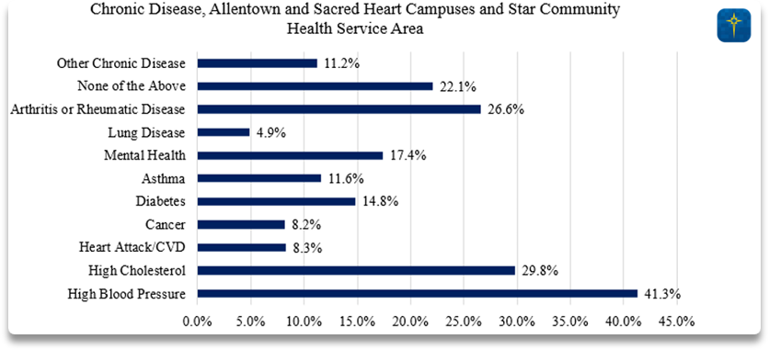
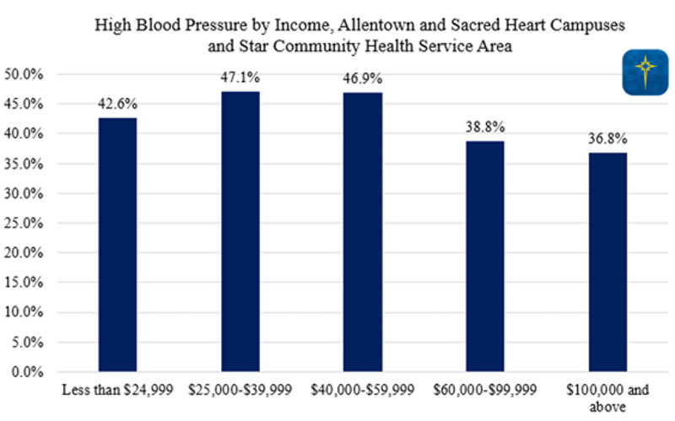
Why Laundry on Linden?
Community need, a trusted point of contact, and prior local screening
The Setting
Allentown and Star Service-Area Context
Laundry on Linden (now Loads of Blessings) provides free laundry on Linden Street in Allentown for people experiencing homelessness or financial hardship. Participants already come for a practical service, so residents can offer BP screening and education on site.
What Earlier Work Found
The earlier residency phase identified elevated BP and tracked clinic follow-up. In 2025, 30 of 54 screened people had BP above 130/80 mmHg. This is a screening finding, not a diagnosis or population prevalence estimate.
CHNA charts reproduced from the original residency slide; they describe the service area, not Laundry on Linden participants.
NI X Meeting Three · October 2026

Slide 35
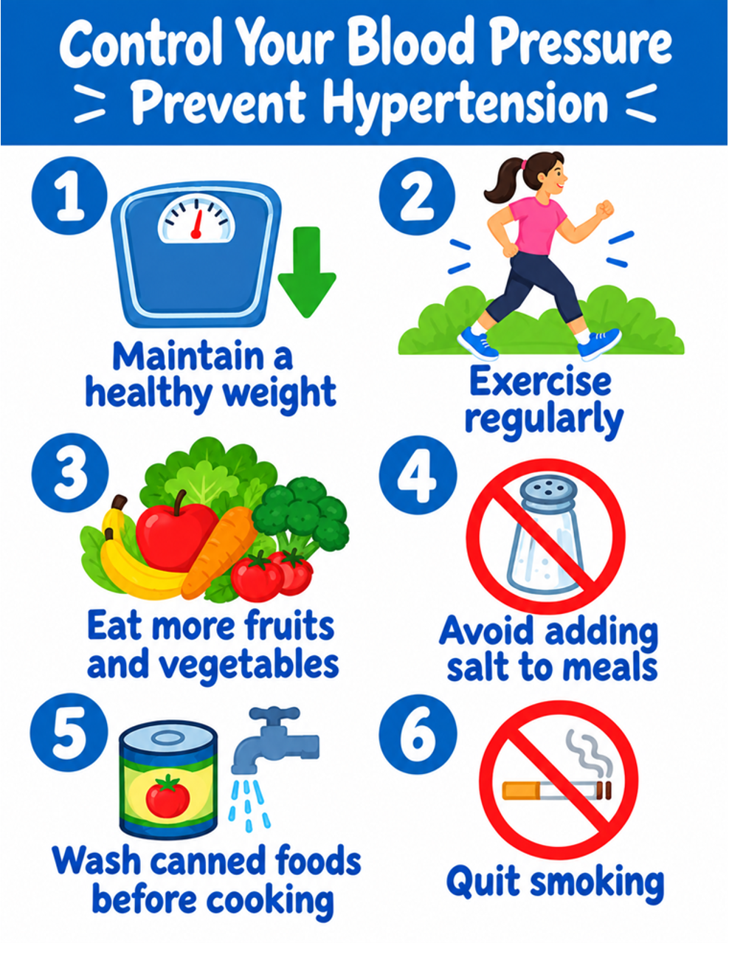
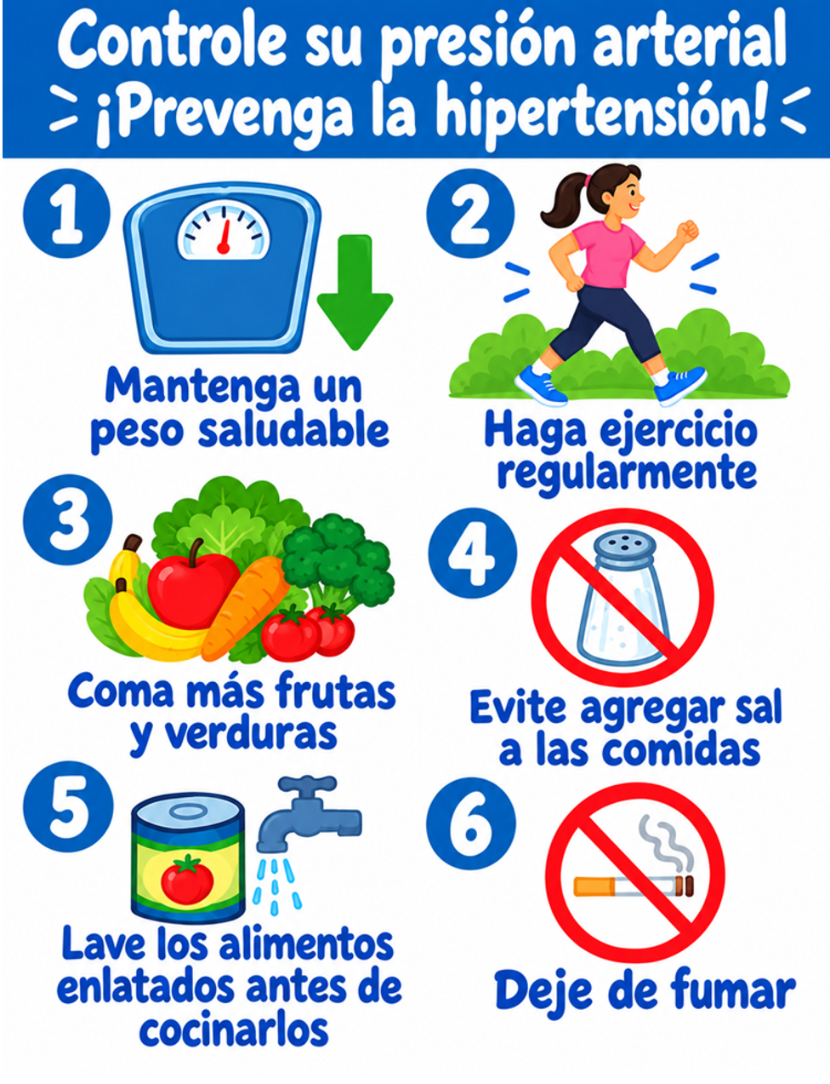
Intervention: Education at the Laundry Site
The handout supports a short conversation about six actions
Visit Flow
English Handout
Spanish Handout
1 Screen BP; ask the belief and action questions.
2 Teach the six actions; give the preferred-language handout.
3 Record education receipt. At the next visit, repeat BP and questions.
Six Actions on Both Checklists
Healthy weight · Exercise · More produce
Less added salt · Rinse canned foods · Quit smoking
The form also displays QR codes so participants can open either handout on a phone.
NI X Meeting Three · October 2026

Slide 36
Measures: What We Record and Compare
A separate form submission and sheet row for every encounter
At Each Visit
Before Education
At Follow-up
Visit type, first and last name, date of birth, systolic BP, and diastolic BP. Use the submission date unless BP was checked on another day.
Belief that hypertension can harm health (Yes/No). Which of the six actions they already do to lower BP. Whether the education was reviewed and given (Yes/No).
Repeat BP and the belief item. Ask which of the six actions the participant has done since the initial visit. The form skips the handout section.
How the Rows Become Study Measures
MATCH
First name + last name + date of birth; order by BP date or submission date.
PRIMARY
Follow-up minus initial systolic BP and diastolic BP.
SECONDARY
New action count, each action, belief change, education receipt, visit interval.
The checklist measures reported behavior. The belief answer is one narrow indicator of understanding.
NI X Meeting Three · October 2026

Slide 37
Project Progression & Early Findings
The current education study builds on two earlier phases
How the Project Evolved
1 · Community rotation
2 · BP screening
3 · Education now
BP and A1c checks at the laundry site; survey resident confidence providing care outside clinic.
Identify high readings and track clinic follow-up. Earlier data: 30/54 above 130/80; 5/54 returned.
BP and pre-questions → six-action teaching → return BP and actions. Clinic connection remains available; it is not a study metric.
Resident Confidence Survey · n = 7 at Each Time Point
“How confident are you in providing care outside the traditional clinic setting?”
Pre · Oct 2025
2
5
Mid
1
3
3
Post
2
5
Very uncomfortable
Somewhat uncomfortable
Pre and post have the same category counts. The mid-survey is more mixed; these totals do not show individual change.
Somewhat comfortable
Very comfortable
Historical resident survey counts supplied by the project team; phase details from the 2025–26 AIAMC deck and original residency storyboard. Clinic referral can continue when needed.
NI X Meeting Three · October 2026

Slide 38
Possible Data Analysis
An exploratory plan for matched initial and follow-up visits
Study Pathway
Education received?
Actions newly reported
BP change
Yes / No at initial visit
Count 0–6; examine each action
Follow-up minus initial SBP / DBP
Match visits by name and birth date. Use BP date when supplied, otherwise submission date. Compare with the first follow-up.
Describe and Compare Within People
Explore the Two Associations
Report the number with paired visits, baseline and follow-up BP, and the mean or median BP change. If the sample allows, show a confidence interval and use a paired test for systolic and diastolic change.
1 Education receipt versus new actions.
2 New action count, then each action, versus BP change. Adjust for initial BP and visit interval if the sample is large enough.
Interpretation: self-reported actions and unmeasured medication changes limit causal conclusions.
NI X Meeting Three · October 2026

Slide 39
Aurora Health Care
AI FM

Slide 40
Introduction: Background & Context
Increasing AI-Related Patient Care Discussions
in Family Medicine Residency Clinics
Aurora Family Medicine Residency
Collin Spencer (presenter), Kevin Lee, Jessica Sefen, Alonzo Jalan, Will Lehmann, Keyonna Taylor-Coleman, Katharine Kelly, Bonnie Bobot, Meinuo Chen-Baca, Samantha Ladin, Stephanie Malusic, Deborah Simpson
AI Integration In Medical Decision Making
Rapid adoption of LLM powered medical search engines.
Data Gap: Can't Analyze What Isn't Measured
Monitor, then encourage open resident-faculty discussion.
The Opportunity
Outpatient staffing facilitates crucial teachable moments.

Slide 41
Aim/Objectives/Alignment
+20%
Our Aim: Increase in discussions between faculty and residents regarding AI utilization during outpatient clinic staffing by +20%.
BASELINE PERIOD
POST PERIOD
Jun 11 - Jul 10, 2026
Jul 11 - Sep 11, 2026

Slide 42



Measures
1. EHR Extraction
2. Data Isolation
3. AI Mining
Epic Reporting Workbench pulled notes containing specific dot-phrase.
Exported to Excel to isolate plain text staffing attestations.
Copilot & Claude extracted non-discrete qualitative markers.
Dot-Phrase: "While staffing this patient with the resident, we reviewed the use of AI in the context of Medical Education:" Yes/No

Slide 43
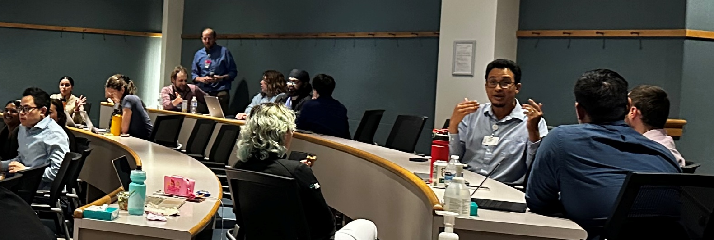
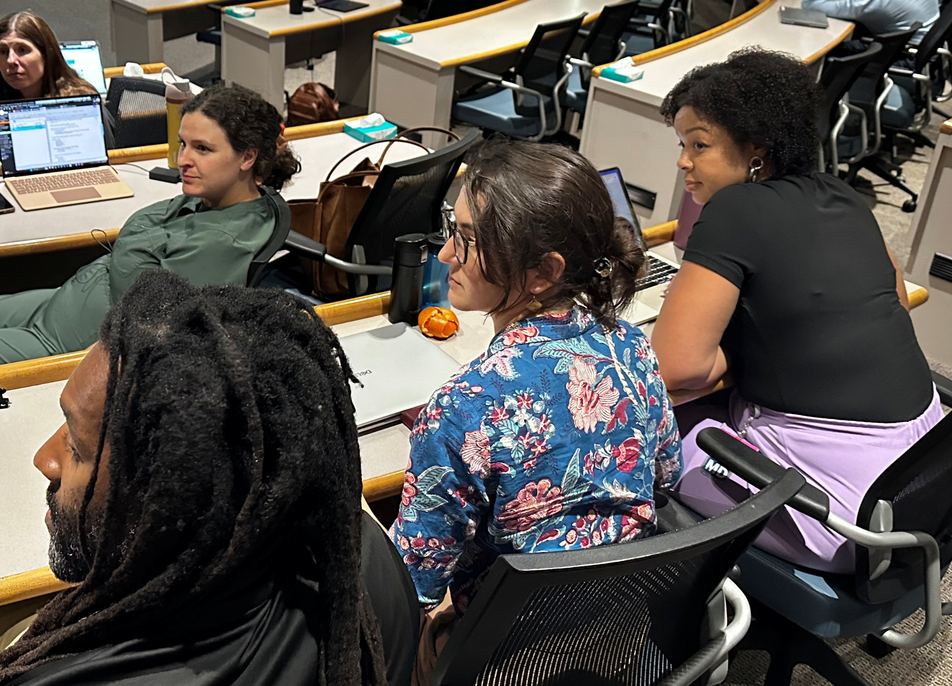
Interventions | Changes
1
Residency Meetings
Dedicated AI discussions integrated into standard meeting agendas.
2
Academic Retreat
Focused educational programming during the annual resident retreat.
3
Leadership Engagement
Targeted reminders modeling appropriate use and helping provide clarity of use.

Slide 44
Barriers Strategies
Non-discrete data limits
LLM Data Mining
Plain text attestations in EHR require time-consuming review.
Utilized Copilot & Claude to successfully extract qualitative answers.
Confounding Baseline Outliers
Dataset
Exclusion
One faculty member had >50% baseline discussion rate but was not available to participate in post-period discussions.
Excluded outlier from final dataset for accurate cohort measurement.

Slide 45
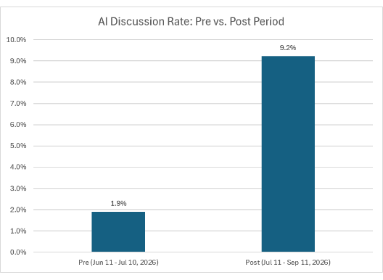

Results
+384%
Relative increase in discussions from pre- to post-period;
far exceeded initial goal
1,168 notes analyzed across the study period.
Peak rates of 14-15% directly followed residency retreat.
8.3% overall rate maintained across entire period.
ABMS/ABFM Part IV MOC Attestations completed by > 30 residents/faculty (required to sit for board exams in FM)

Slide 46

Discussion
Targeted Engagement Works
Reminders and leadership engagement drove immediate behavioral change in clinical education.
Next Steps
Integrate AI discussion prompts into routine workflows.
Identify best teaching strategies for clinical AI complexity.
Evaluate comfort and mastery
QI Administrative Innovation
LLM streamlined EHR text extraction, proving valuable administrative utility for efficient evaluation of QI project data.
Areas for Guidance
Leveraging sustained intentional-dialogue in the development and application of AI curriculum for residency training

Slide 47
Ochsner Health

Slide 48

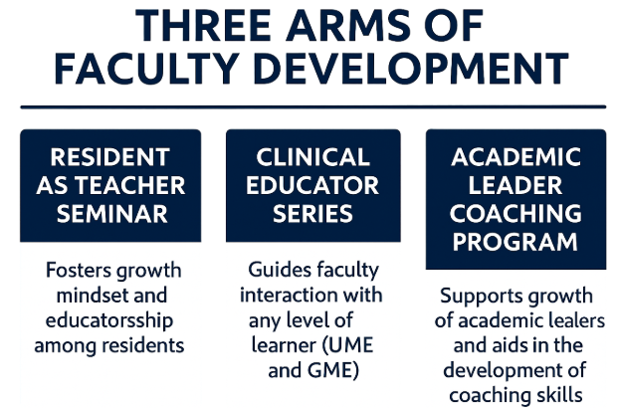

Optimizing the Clinical Learning Environment Through
Structured Faculty Development
Brittany Ducote, M.B.A.; Rajiv Gala, MD; Amy Lin, MD; Anna White, MD; Roneisha McLendon, MD; Donna Guidroz
Introduction: Background & Context
Methods: Interventions
Results: Preliminary
At Ochsner, our project goal is to create a unified, institution‑wide approach to faculty development that strengthens teaching quality and advances academic excellence across the Clinical Learning Environment (CLE).
By consolidating previously siloed efforts into a structured, measurable program, the initiative supports faculty in developing their educator identity, engaging in lifelong learning, and contributing meaningfully to a high‑performing clinical training culture.
Grounded in the ACGME Clinical Educator Milestones, the program integrates self‑reflection, mentorship, and evidence‑based teaching practices while aligning with broader institutional priorities.
Phase 1: Final Prep (Jan–Jun 2026) — Finalize curriculum materials, secure facilitators, and establish baseline measurement tools.
Phase 1
January 2026 – Identify key arm champions for faculty development
Phase 2: Curriculum Launch (Jul–Dec 2026) — Launch all three arms (Resident as Teacher, Clinical Educator Series, Academic Leader Coaching Program) and begin initial data collection.
February 2026 – AMA GME Competencies Program Module Review and Purchase
March 2026 – Faculty development rollout plan meeting for UME initiatives
Phase 3: Pilot Refinement & Expansion (Jan–Jun 2027) — Evaluate early implementation, refine modules using feedback, and expand participation across programs.
May 2026 – GME Advancement Session to review rollout plan of GME FD initiatives
Phase 4: Full Institutional Integration (Jul 2027–Jun 2028) — Embed curriculum components into routine faculty development expectations and into GME/UME evaluation systems.
June 2026 – LCME Site Visit – Xavier Ochsner College of Medicine
Phase 2
July 2026 – Begin initial data collection
Aim & Objectives
October 2026 – Xavier Ochsner College of Medicine LCME Status
Through phased implementation the project aims to enhance teaching effectiveness, improve feedback and assessment practices, and foster a more inclusive, psychologically safe CLE.
December 2026 – Review initial data collection
January 2027 – GME Learner onboarding and AMA Module distribution for Resident as Teacher; Clinical Educator and Academic Leader Coaching Program begin
Enhance teaching effectiveness
Improve feedback and assessment
Foster a more inclusive, psychologically safe CLE
Discussion
Critical Next Steps
Finalize curriculum materials and rollout logistics for July 1, 2026
Complete IRB determination and prep data‑collection tools
Identify facilitators and departmental champions
Launch communication plan and onboarding for faculty/residents
Begin baseline measurements for engagement and educator milestones
Current Challenges / Areas for Input
Selecting the most effective delivery format(s) for busy clinical faculty
Ensuring equitable participation across departments with variable workloads
Integrating new milestone assessments into existing evaluation systems
Aligning faculty development expectations with institutional incentives
Building sustainable coaching capacity for academic leaders
Alignment & Organizational Priorities
Methods: Measures/Metrics
Our project is grounded in our organizational core values at Ochsner Health New Orleans. Striving for excellence, we aim for the highest standards in supporting the education and academic mission with a central focus on valuing our patients and providing compassionate care.
Increase faculty participation to at least 60% of eligible faculty by June 2027.
Improve teaching effectiveness scores by 10% across UME/GME evaluations within the first year of implementation.
Demonstrate milestone growth for at least 70% of participants between baseline and 12‑month follow‑up.
Enhance CLE culture metrics (psychological safety, inclusivity, feedback quality) by 5–8% as measured through annual surveys.

Slide 49
St. Lukes University Health Network
Rapid Response Simulation

Slide 50

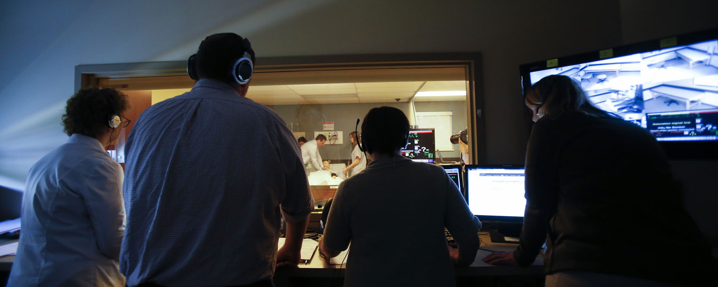

Rapid-Response Simulation Study
E Butler - M Sanoh - Y Kerego - S Cardio - P Kaur - J Sotherland
St. Luke's University Health Network
Introduction: Background & Context
Interventions/Changes
Implementation of collaborative simulation training sessions involving internal medicine residents and novice nurses
Each learner is given pre and post simulation surveys with Likert scale items and open-ended responses
Structured debriefs occur post-simulation to promote reflective learning, feedback exchange, and professional identity formation
Plan to integrate findings into curriculum development for sustained impact
No changes have been made to the surveys or simulations yet
Results: Preliminary
Simulation–based learning has been shown to be a highly effective learning modality for collaborative training, particularly in the healthcare field where teamwork and communication are critical for effective and appropriate patient care
Preliminary (ongoing study)
Marked improvement in communication, role clarity and clinical decision-making confidence after simulation
Measure | Nurses (n=50) |  | Residents (n=26)
 | Pre-simulation | Post-simulation | Pre-simulation | Post-simulation
Confidence in closed‑loop communication | 61.2% | 96.1% | 68% | 96%
Not comfortable sharing critical info in timely manner | 49% | 7.9% | 20% | 7.4%
Do not understand role (role clarity) | 49% | 4% | 32% | 0%
Not comfortable expressing concern | 36.8% | 8% | 32% | 7.4%
Confidence in identifying/prioritizing clinical problems | — | -— | 56% | 92.6%
Confidence in anticipating complications | — | — | 68% | 96.3%
Confidence in choosing intervention | — | — | 64% | 89.9%
Prior sim experience | 81.6% |  | 56%
Measures
Primary outcomes:
Change in mean domain scores (pre → post) for:
  Self‑confidence
  Debriefing satisfaction
  Perceived clinical decision‑making skills
Secondary outcomes:
Subgroup analyses by:
  Profession (nurse vs resident)
  Year(s) of training
  Clinical experience
Purpose:
Quantify simulation effectiveness for perceived confidence and competence in high-stakes teamwork, communication, and decision making
Identify domains and participant groups needing additional focus
Aim/Objectives/Alignment
We aim to enhance the preparedness of our leaners through evidence-based simulation training
Evaluate the added value of interdisciplinary simulation to address gaps in .
We align with our broader objectives as an organization to use data driven methods to inform curriculum design and foster continuous improvement
Discussion
Current steps
Active involvement of teams of residents and nurses in simulation.
Ongoing data collection
Interpretation of Preliminary Results
Significant improvement in post simulation data.
Next Steps
Completion of survey collection.
Full statistical analysis of pre and post simulation outcomes.
Expansion of simulation curriculum to other clinical units.
Important Caveat
Small sample size due to incomplete data collection
Self-reported measures
Communication Techniques
Interdisciplinary Collaboration
Crisis Leadership & Judgment
Reflective Practice & Debrief
Teams-based practice
Enhanced interprofessional collaboration
Improved patient care outcomes
Scheduling Conflict: Coordinating sessions around resident and nursing schedules.
Small participant size: offer multiple sessions
Inconsistent survey completion: send reminders

Slide 51
INTRODUCTION
Rapid response events require residents and nurses to communicate, understand their roles, and make clinical decisions together under pressure.
Our study uses collaborative evidence-based simulation training to strengthen those skills among internal medicine residents and nurses.
We are evaluating whether participants’ confidence and perceived decision-making improve after simulation.”

Slide 52
AIM OF THE PROJECT
Our aim is to assess the value of interprofessional rapid response simulation in preparing learners for high-stakes teamwork.
We are measuring changes in self-confidence, perceived clinical decision-making, and satisfaction with the debriefing.
We also plan to examine whether results differ by profession, years of training, or clinical experience
Communication Techniques
Interdisciplinary Collaboration
Crisis Leadership & Judgment
Reflective Practice & Debrief

Slide 53
DATA COLLECTION/METHOD
We are collecting pre- and post simulation survey responses using Likert-scale items and open-ended questions.
The surveys cover confidence, perceived decision-making, and debriefing satisfaction.
Our preliminary data show improvement after simulation in communication, role clarity, and confidence in clinical decision-making.
The study is ongoing, so the findings are preliminary; the sample is small, survey completion has been inconsistent, and the measures are self reported.”
The process involves bringing nurses and internal medicine together for the simulation training. Participants completed surveys before and after the simulation We used structured debrief to support reflection, feedback exchange, and discussion of team roles. We are continuing data collection and plan to complete the analysis before using the findings to inform curriculum development.

Slide 54
BARRIERS AND STRATEGIES
Scheduling conflicts between residents and nurses | Offer multiple sessions
Small participant sample | Coordinated schedules with nursing and residency teams in advance
Incomplete survey responses | Send reminders to improve survey completion
Self-reported measures may not reflect actual performance | Allow more time for follow-up and analysis

Slide 55
What we would do differently next time
We plan to build in more time for recruitment and scheduling
Plan to offer multiple sessions, and send survey reminders
In hindsight, the scheduling demands of coordinating two professions, the risk of a small sample, and incomplete survey responses were potential threats to the project from the start.
We also could have anticipated that the self reported measures would not tell us whether participants performance changed.
Identifying these earlier would have helped us plan additional sessions, reminders, and objective measures from the beginning.

Slide 56
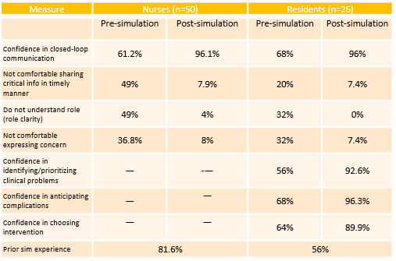
RESULTS

Slide 57
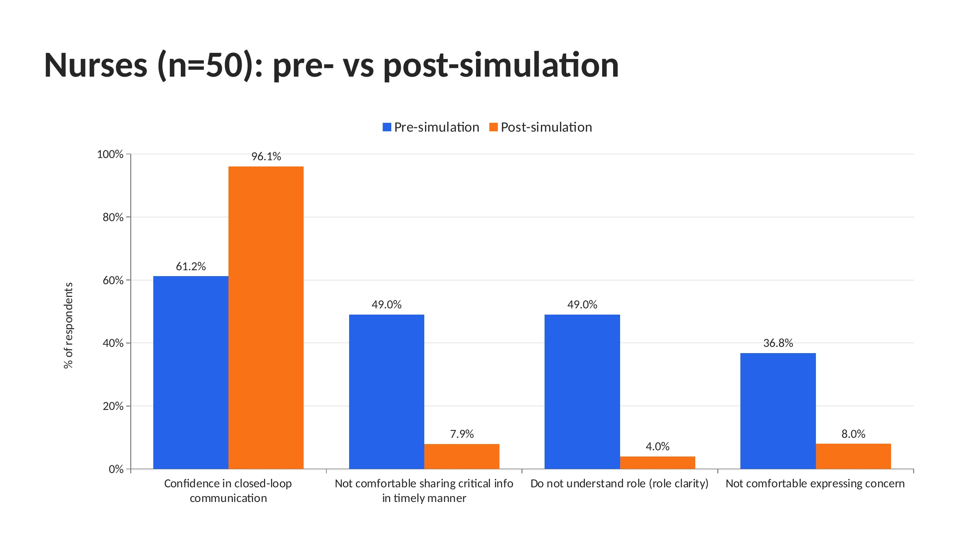
RESULTS

Slide 58
DISCUSSION
Current steps
Active involvement of teams of residents and nurses in simulation.
Ongoing data collection
Interpretation of Preliminary Results
Significant improvement in post simulation data.
Next Steps
Completion of survey collection.
Full statistical analysis of pre and post simulation outcomes.
Expansion of simulation curriculum to other clinical units.
Important Caveat
Small sample size due to incomplete data collection
Self-reported measures

Slide 59
Atrium Health CMC

Slide 60

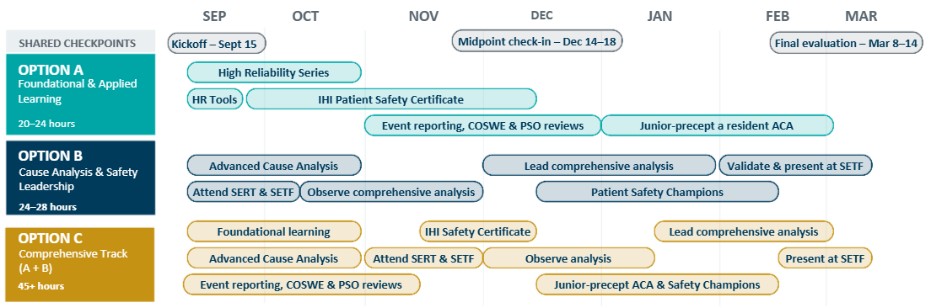
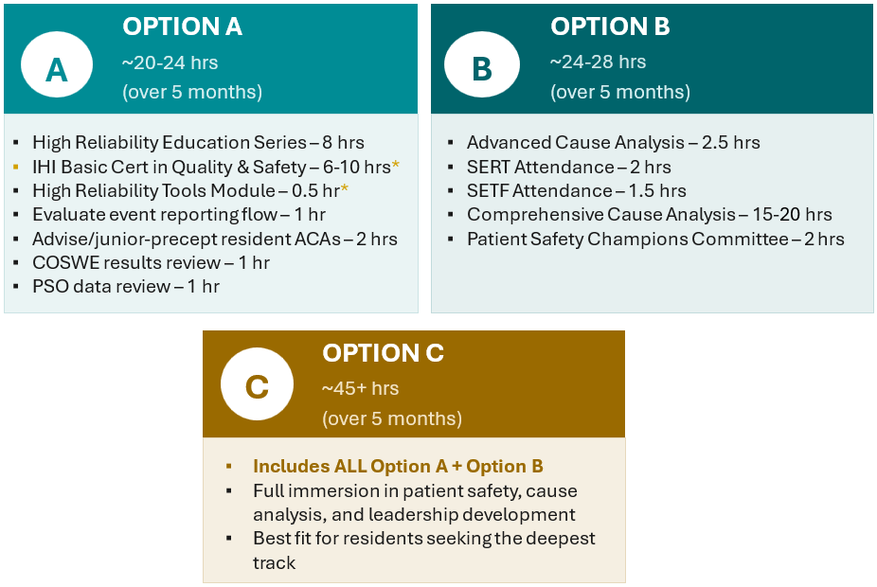
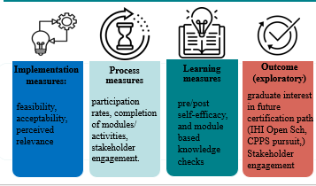



Carolinas Medical Center: Pathway to Patient Safety Professional
Aaron Williams, MPS, CPPS| Jennifer Wellington, DO,MSC| Emily Harrison, MBA | Jennifer Molino, PT, DPT, WCS, CPPS| Daniel Handel, MD, MBA,MPH | Suzette Caudle, MD
Introduction: Background & Context
Interventions/Changes
Results: Preliminary
For nearly a decade, GME and Patient Safety have collaborated to involve yr 1 residents/fellows in patient safety event analyses.
We have developed a patient safety pathway tailored to rising senior residents and fellows who seek a deeper level of engagement in patient safety, providing advanced learning and experiential opportunities in patient safety principles and practice.
Results of the internal needs assessment guided development of the pilot Patient Safety Pathway.
The highest-ranked activities included participation in safety event analyses (AAR, ACA, RCA), mentorship and precepting of junior residents in safety work, and engagement with patient safety culture assessment.
These priorities were incorporated into 3 pathway experiences focused on practical safety investigation skills, leadership development, and systems-based improvement.
12 learners, supported by their PDs, signed up to participate across all pathway options.
Number of Participants Per Pathway
Option A | Option B | Option C
5 | 4 | 3
Pilot Pathway Timeline
Aim/Objectives/Alignment
We aim to develop a Pathway of Distinction in Patient Safety for all residents and fellows who wish to deepen their expertise in high reliability science, cause analysis, and systems thinking. We initiated a pilot featuring key elements of the proposed Patient Safety Pathway. The pilot will be conducted over several months to refine curriculum components and implementation strategies, with a finalized pathway anticipated by March 2027 and formal launch planned for AY 2027-2028.
Supports Strategic Organizational Priorities:
This project directly aligns with Advocate Health’s Rewire 2030 and our strategic differentiator "build the pre-eminent national academic and innovation ecosystem" while improving health and safety outcomes. Also:
Enhance Psychological Safety and Just Culture across clinical learning environments impacts all teammates.
Prepare future patient‑safety leaders for Atrium Health and the broader healthcare community.
Potentially enhances retention
Supported by Executive Leadership
Supported by Data & National Guidance
Discussion
Next Steps
Clarify incentives for pilot participants
Develop & Implement evaluation instruments
  Each activity
  Preceptor of trainee, trainee of pilot (mid-pilot, end of pilot)
  Feasibility of curriculum
Draft full curriculum outline based on feedback
Submit IRB
Challenges Strategies
Running concurrent pilot activities may limit preference comparisons but may accelerate learning and feasibility testing.
Measures
IRB approval pending due to project
restructuring
Submit protocol with clear educational framing
Identifying an initial diverse cohort across programs
Partner with PDs to nominate residents/fellows via defined criteria's
Concurrent pilots may blur trainee preferences
Collect activity‑level feedback
and brief debriefs
Key Terms
Safety Event Task Force (SETF)| After Action Review (AAR) | Apparent Cause Analysis (ACA) | Root Cause Analysis (RCA) | Patient Safety Organization (PSO) | Culture of Safety & Work Environment (COSWE) | Program Director (PD)
National Initiative X, Meeting #3, October 9, 2026

Slide 61

Final Thoughts
Facilitator and National Advisory Council
Facilitators:
Kelly Ussery-Kronhaus, MD, FAAFP, Hackensack Meridian Health Ocean University Medical Center
Theresa Azevedo Rousso, MPA, Regional Senior Director and Designated Institutional Official, Kaiser Permanente Northern California
National Advisory Council:
Lisa Crouse, MD, MS, FACOG, Senior Vice President, Institutional and Program Accreditation
Julie Dagam, PharmD, BCPS, FASHP, FPSW, Director, Residency Accreditation Services, American Society of Health System Pharmacists

